Slide 1
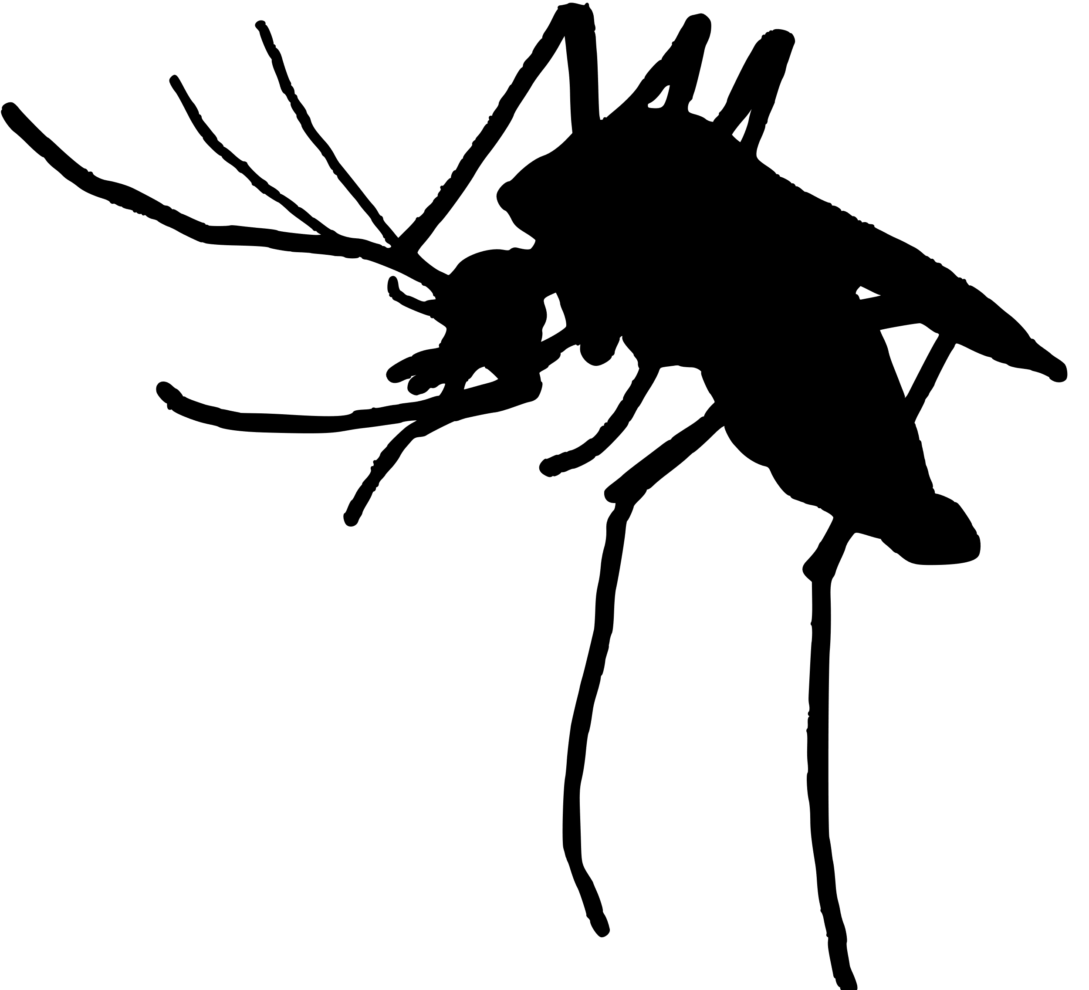
The mathematics of mosquito-borne parasite transmission
Kyle Dahlin
Postdoctoral Fellow
Virginia Tech Department of Mathematics and
Center for Emerging, Zoonotic, and Arthropod-borne Pathogens

Slide 2
Introduction: Outline
Mosquito-borne diseases are one of humanity’s oldest AND newest problems
We co-evolved with malaria – it continues to kill 100s of thousands of people, particularly children under 5 in Africa
Over 25% of emerging infectious diseases – those which… – are zoonotic mosquito-borne diseases
Despite massive advances in science and technology, these diseases continue to threaten global public health
But progress has been continual and there is hope for significant strides in the near future
I’ll tell you the story of the battle against mosquito-borne diseases over the past century and show you how mathematics have contributed to progress

Slide 3
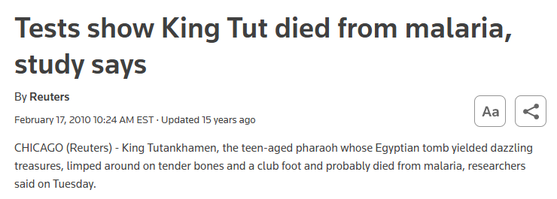
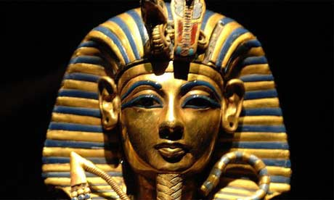
Mosquito-borne diseases are one of humanity’s oldest and newest problems
Our species co-evolved with malaria parasites

Slide 4
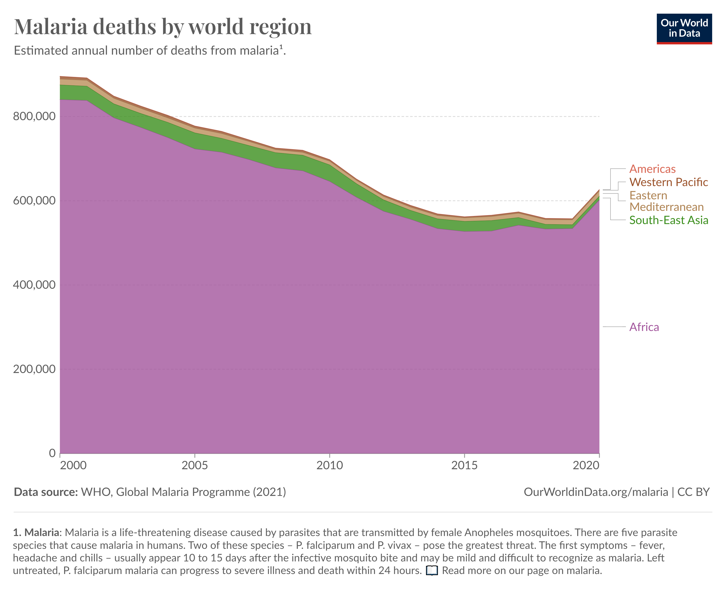
Mosquito-borne diseases are one of humanity’s oldest and newest problems
Our species co-evolved with malaria parasites
Yet it continues to kill >500,000 people annually, particularly children under 5 in Africa

Slide 5
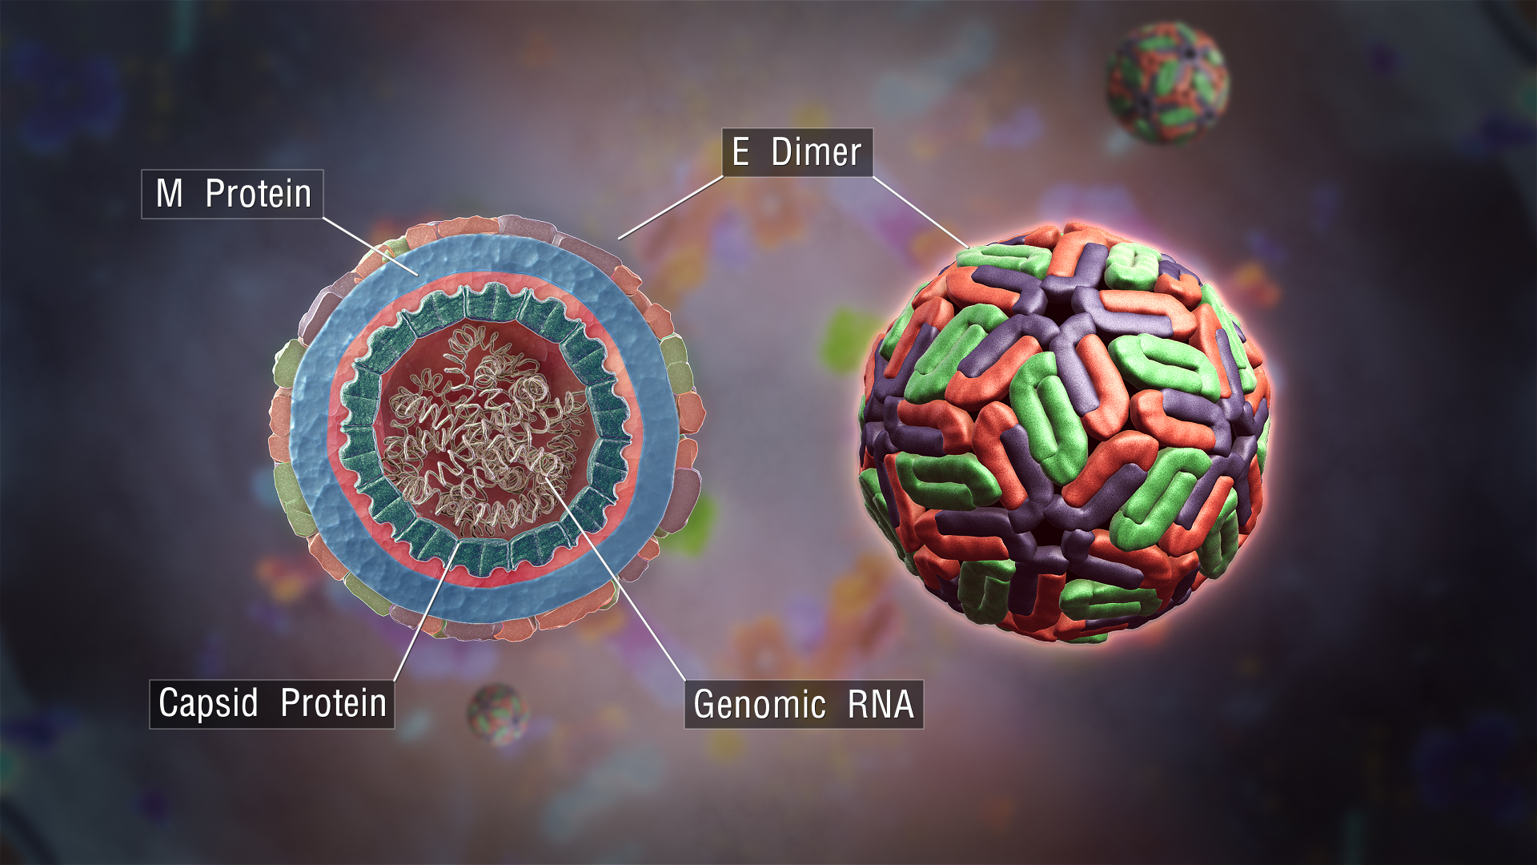
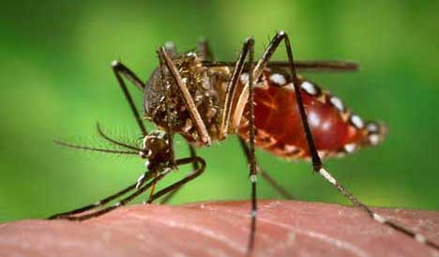
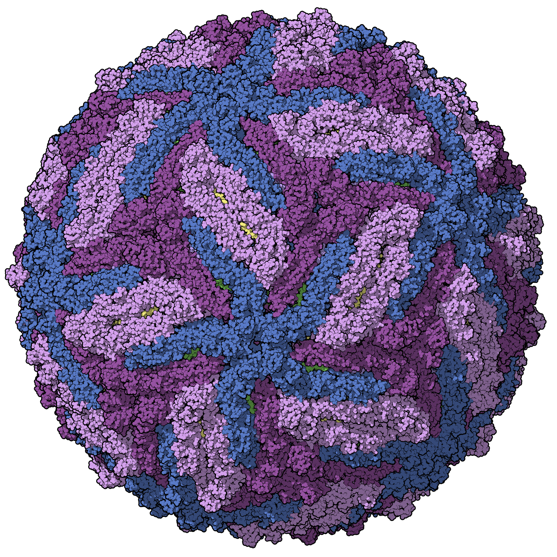
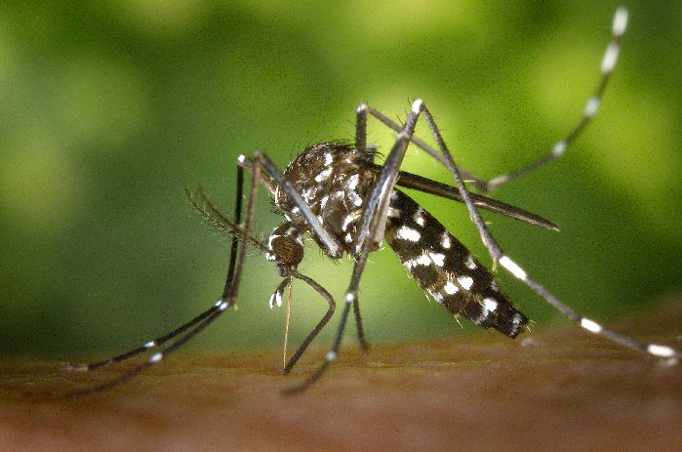
Mosquito-borne diseases are one of humanity’s oldest and newest problems
Over 25% of recent emerging* infectious diseases are zoonotic* mosquito-borne diseases
Ex: Zika, dengue, chikungunya, West Nile Virus, yellow fever, malaria(s)
Aedes aegypti (CDC.gov)
Dengue virus virion (ScientificAnimations.com)
Zika virus virion
(Manuel Almagro Rivas)
Aedes albopictus (CDC.gov)

Slide 6
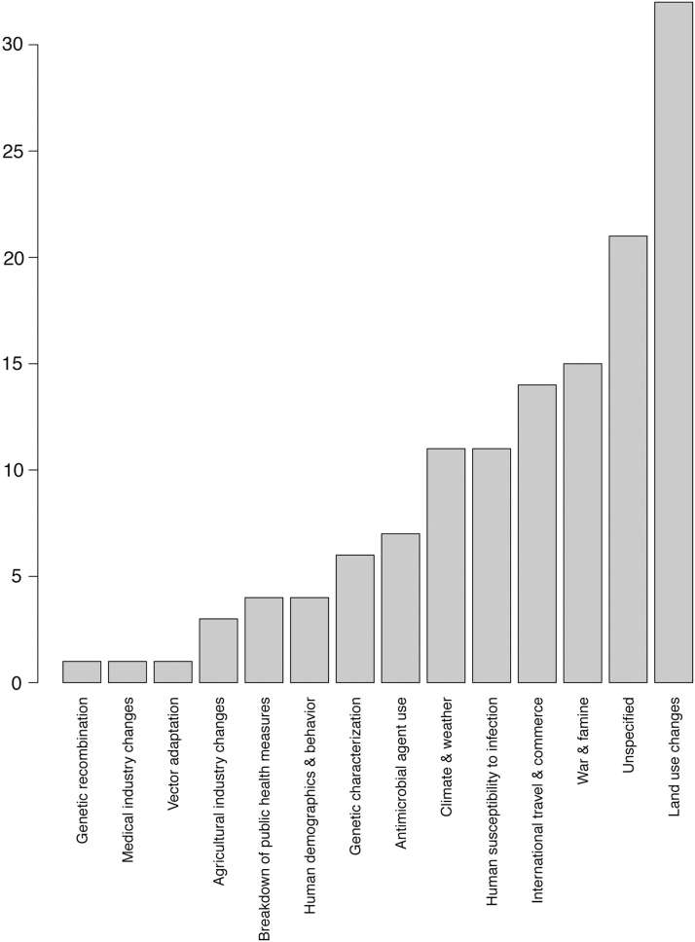
Mosquito-borne diseases are one of humanity’s oldest and newest problems
Over 25% of recent emerging* infectious diseases are zoonotic* mosquito-borne diseases
Ex: Zika, dengue, chikungunya, West Nile Virus, yellow fever, malaria(s)
Resurgence is connected to:
Global climate change
Air transport networks
Changes in land-use
….

Slide 7
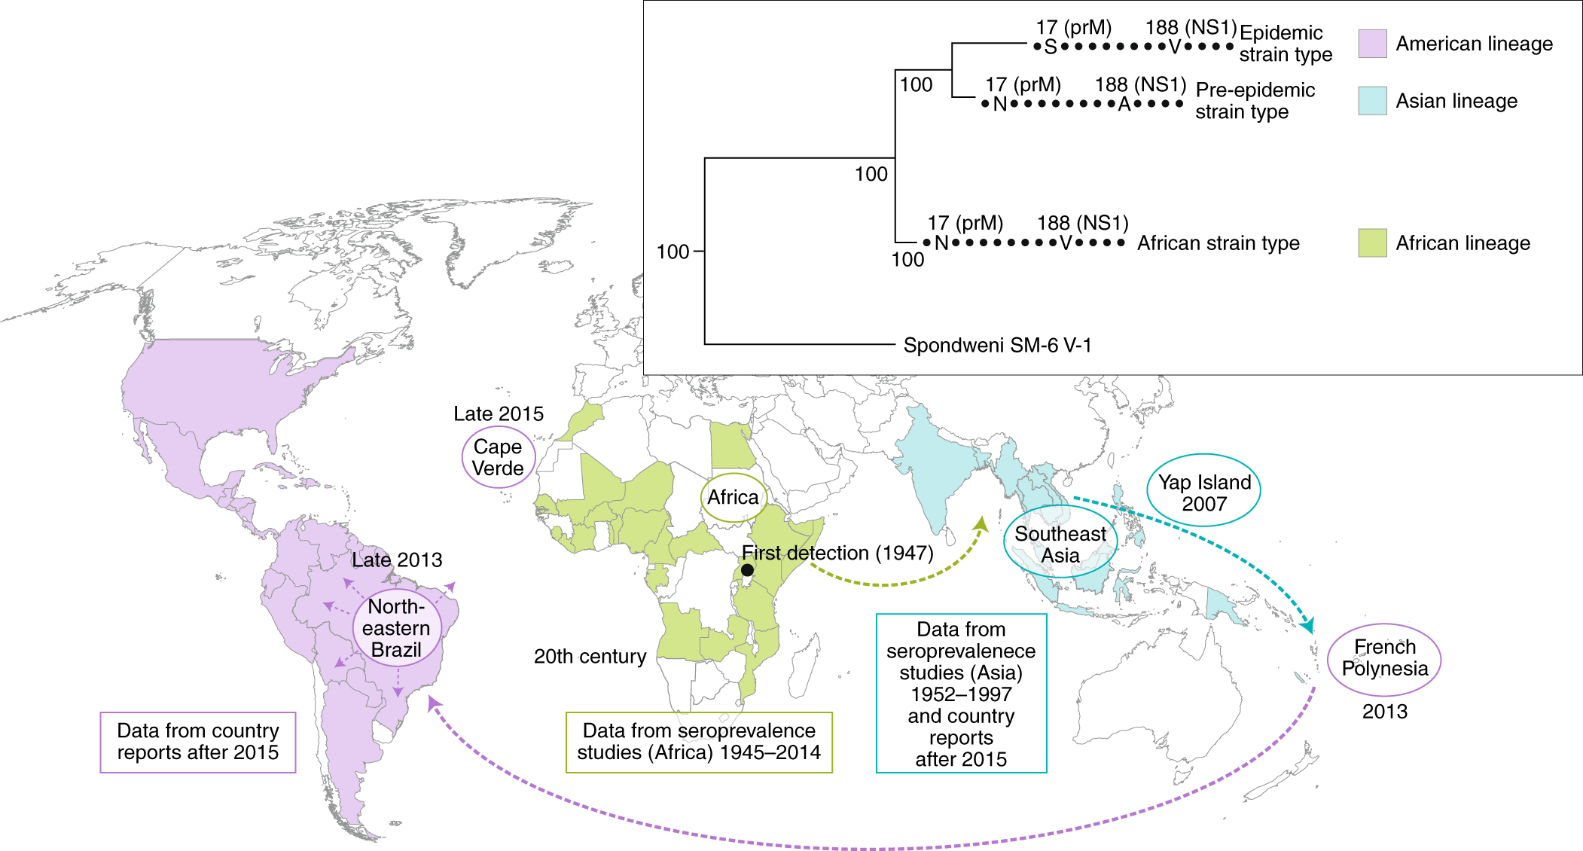
Emergence and evolution of Zika virus vector-borne transmission
Gutiérrez-Bugallo, et al. 2019. “Vector-Borne Transmission and Evolution of Zika Virus.” Nature Ecology & Evolution 3 (4): 561–69. https://doi.org/10.1038/s41559-019-0836-z.

Slide 8
Emergence and evolution of Zika virus vector-borne transmission
Gutiérrez-Bugallo, et al. 2019. “Vector-Borne Transmission and Evolution of Zika Virus.” Nature Ecology & Evolution 3 (4): 561–69. https://doi.org/10.1038/s41559-019-0836-z.

Slide 9
Emergence and evolution of Zika virus vector-borne transmission
Gutiérrez-Bugallo, et al. 2019. “Vector-Borne Transmission and Evolution of Zika Virus.” Nature Ecology & Evolution 3 (4): 561–69. https://doi.org/10.1038/s41559-019-0836-z.

Slide 10
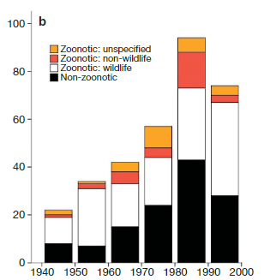
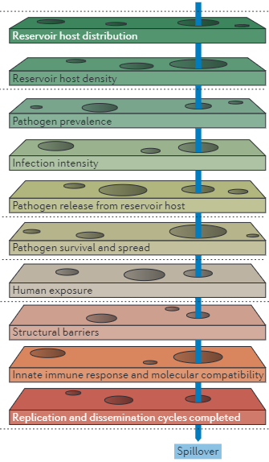
Emergence and spillover of zoonoses
Plowright, R., Parrish, C., McCallum, H. et al. Pathways to zoonotic spillover. Nat Rev Microbiol 15, 502–510 (2017).
Most emerging infectious disease events originated from exposure to pathogens originating in wildlife (zoonoses) (Daszak et al., 2020)
Processes underlying spillover are incredibly complex (Plowright et al., 2017)
We’d very much like to identify the reservoir(s) of the next pandemic(s)
Jones, K., Patel, N., Levy, M. et al. Global trends in emerging infectious diseases. Nature 451, 990–993 (2008).

Slide 11
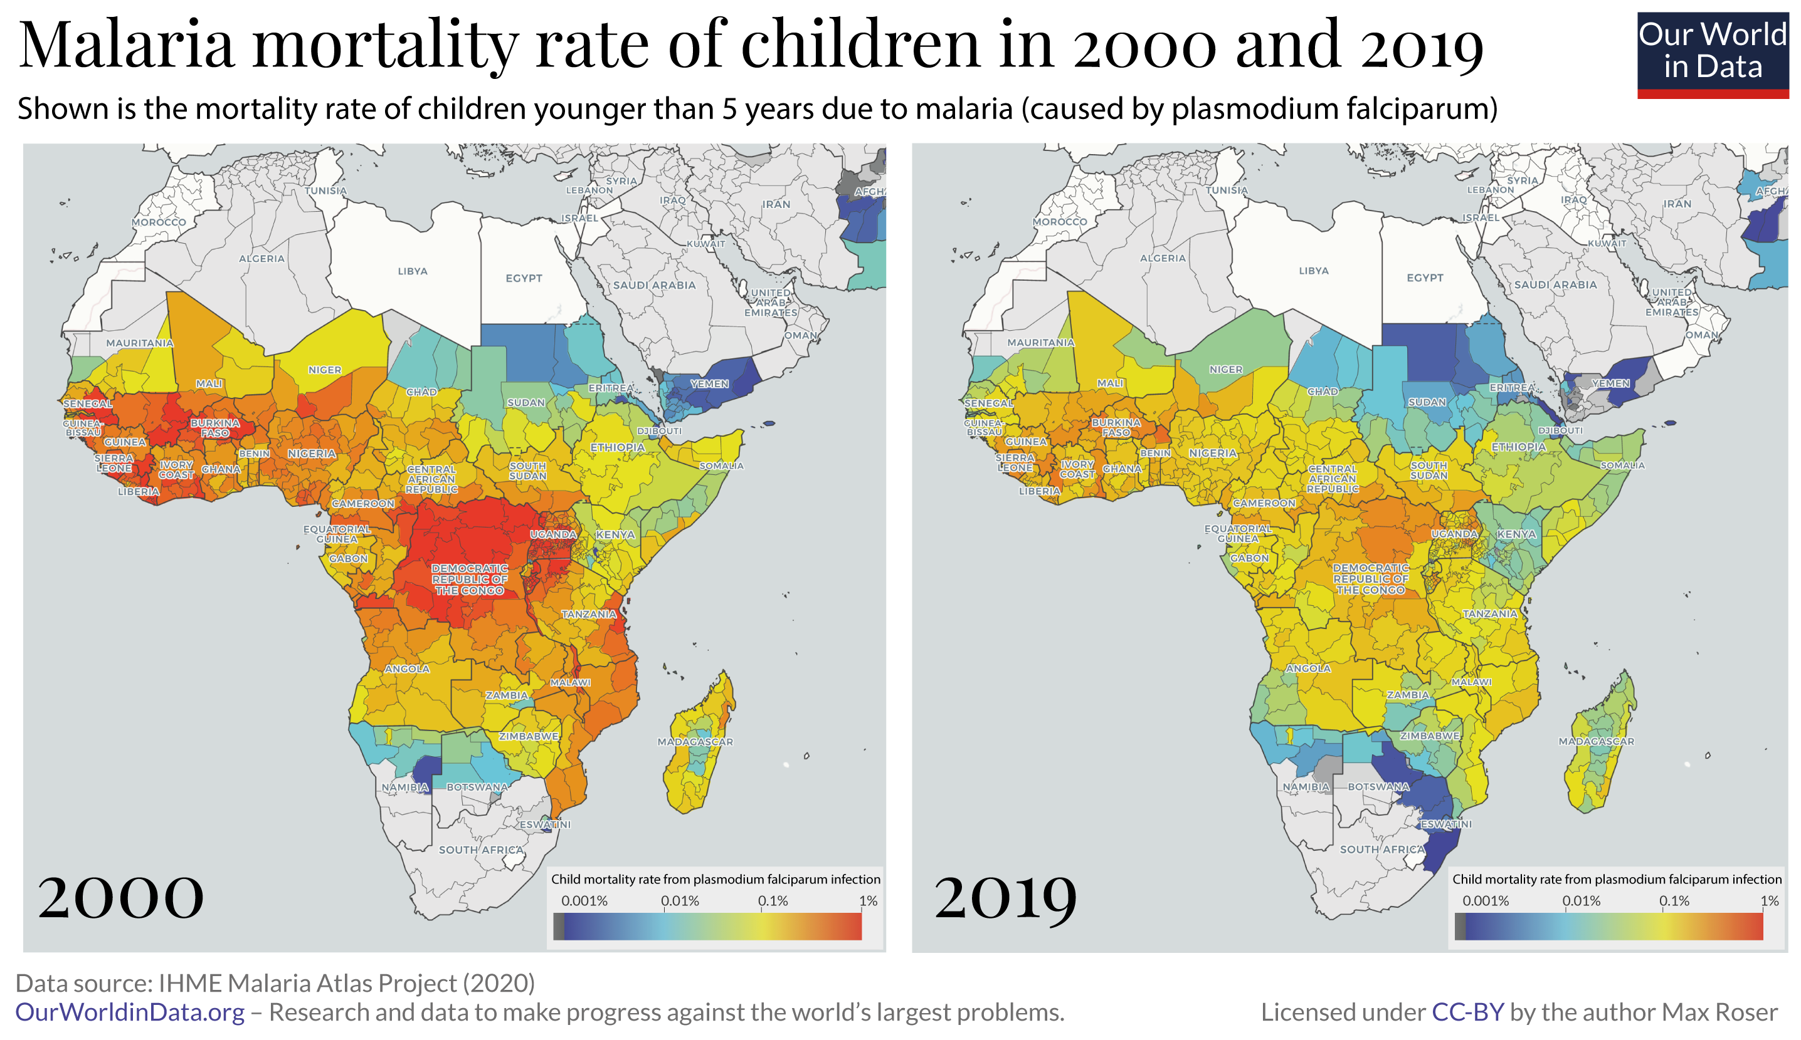
Despite massive advances in science and technology,
mosquito-borne diseases continue to threaten global public health
Notes:
https://ourworldindata.org/malaria

Slide 12
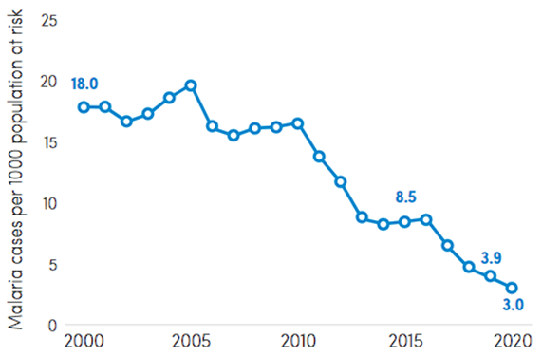
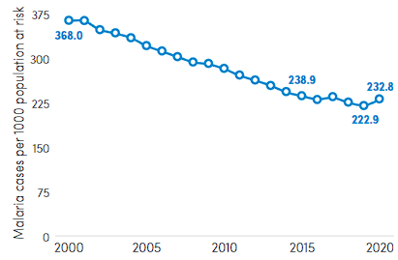
The 21st century saw continual improvement, but recently
progress on the goal of Malaria Elimination by 2030 has stalled
South-East Asia region
Africa region
Notes:
> 200 million cases of malaria and up to 400 million cases of dengue
>25% recent emerging infectious disease outbreaks due to MBDs (Jones 2008, Gould 2017)
Malaria has seen a recent uptick in some regions (World Malaria Report 2021)
Predicting MBD outbreaks is complex, needing to account for:
ecology of multiple hosts,
life history of the insect vectors, and
the traits of the pathogens themselves
environmental variables
coinfection
movement
immunology

Slide 13
Outline
The biology of mosquitoes and the parasites they spread, in brief
How mathematics and mosquito-borne diseases met
Survey of recent topics (as time allows)
Coupled within-host and between-host models
Effects of temperature
Spatial and movement modeling
Infertile insect techniques

Slide 14
1. The biology of mosquitoes and the parasites they spread

Slide 15
Background: Outline
Why do mosquitoes bite?
For reproduction
How do they bite?
Who are the culprits? (some example mosquito species with pictures)
Mosquito-borne diseases
Two major types: malarias (protists) and arboviruses (ar(thropod)-bo(rne) viruses)
Call back to the mosquito species and point out that only certain species vector certain pathogens
Transmission types: environmental, direct, and vector-borne
What are the advantages and disadvantages of vector-borne transmission?
Where do mosquito-borne diseases come from?
Ancient guesses: “mal aria” – bad air
Malaria is partially responsible for the rise and fall of Rome: the malaria-ridden swamps (Roman Compagna) surrounding Rome made it difficult to besiege. Later waves of epidemics may have caused depopulation of the city due to deaths and emigration.
Modern answers: Ronald Ross’ Nobel Prize(?) for discovering how malaria is transmitted (actually it was using avian malaria)
Where did malaria “come from”?
Where do emerging arboviruses “come from”?
Notes:
Just show the Disney video to start with:
https://www.youtube.com/watch?v=y68F8YwLWdg

Slide 16


Slide 17
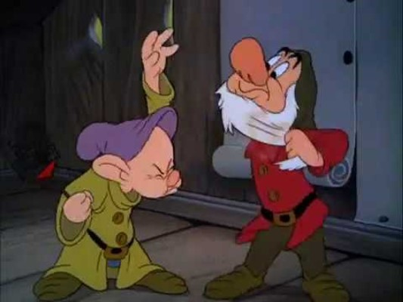

Slide 18
Math: Outline
Set the scene: 19th / early 20th century India
Malaria is causing a lot of human misery and, unlike (insert other diseases which have treatments / preventions), there is no end in sight
Ronald Ross, who we heard of earlier, is tasked with reducing transmission and preventing outbreaks
After his discovery of mosquito-borne transmission, the common thought is that ending transmission will require complete elimination of mosquito populations – which is nearly impossible to do when they can breed in any standing water as small as a water bottle cap
Quinine and IPAs is a “fun” mention
Ross’ Model
Ross thought that there might be a way to break transmission chains without complete elimination – he developed a mathematical model to examine his hypothesis
Derive the model with a diagram (steal it from someone’s paper)
Do the basic analysis showing that I(t) → 0 when R_0 < 1
Ross found that by reducing the availability of mosquito larval habitat (standing water) below a certain threshold, the transmission of malaria should eventually end
Caveats!
But this argument got him the resources he needed to do something about his problem. Even if the predictions weren’t quite accurate, it’s believable that his intervention would have a meaningful impact based on our understanding of the mechanisms and drivers of transmission.
These interventions – developed directly from Ross’ model’s predictions – were effective at all but eliminating malaria in region of India (double-check)
Mathematical techniques
Derive the general SIR-SEI model.
Do the threshold analysis on the board
Show how flexible this framework is
SI(SRS)-S(E)I etc.
Consider introducing the innovations of Macdonald and others (what will this add?)
Notes:
References:
Smith, David L., Katherine E. Battle, Simon I. Hay, Christopher M. Barker, Thomas W. Scott, and F. Ellis McKenzie. 2012. “Ross, Macdonald, and a Theory for the Dynamics and Control of Mosquito-Transmitted Pathogens.” PLoS Pathogens 8 (4): e1002588. https://doi.org/10.1371/journal.ppat.1002588.
Martcheva, Maia. 2015. An Introduction to Mathematical Epidemiology. Texts in A. New York, NY: Springer US. https://doi.org/10.1007/978-1-4899-7612-3. Brauer, Fred, Carlos Castillo-Chavez, and Zhilan Feng. n.d. Mathematical Models in Epidemiology. Springer New York. Accessed January 20, 2023. https://doi.org/10.1007/978-1-4939-9828-9.
Thongsripong, Panpim, James M. Hyman, Durrell D. Kapan, and Shannon N. Bennett. 2021. “Human-Mosquito Contact: A Missing Link in Our Understanding of Mosquito-Borne Disease Transmission Dynamics.” Annals of the Entomological Society of America 114 (4): 397–414. https://doi.org/10.1093/aesa/saab011.

Slide 19
2. How mathematics and mosquito-borne diseases met

Slide 20
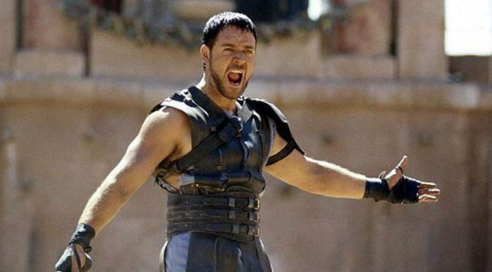
The start of malariology
Malaria is partially responsible for the rise and fall of Rome:
Malarious swamps surrounding Rome made it difficult to besiege
Later, waves of epidemics depopulated of the city due to deaths and emigration
Where does malaria come from?
“mal aria” – bad air
Malaria – “the king of diseases” – has plagued India as far as back as1500 BCE
“Gin and tonic” – quinine was a sometimes-effective treatment of malaria
When was it discovered that malaria is transmitted by mosquitoes?

Slide 21
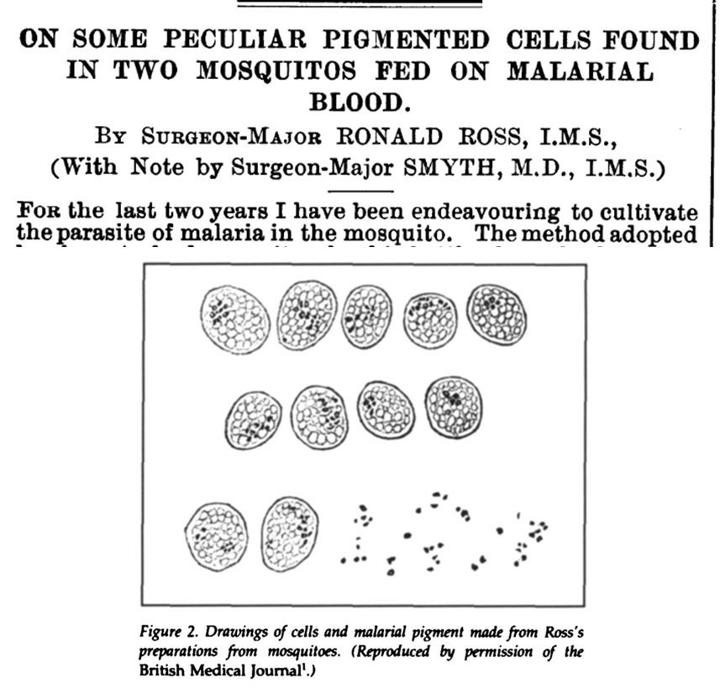
Ronald Ross: identifying the enemy
1897: Ronald Ross, a British surgeon stationed in India, discovered that mosquitoes could become infected with malaria parasites
1898 Ross discovered that (avian) malaria was transmitted by (Culex) mosquitoes
For this work, he received the Nobel Prize for Medicine in 1902

Slide 22
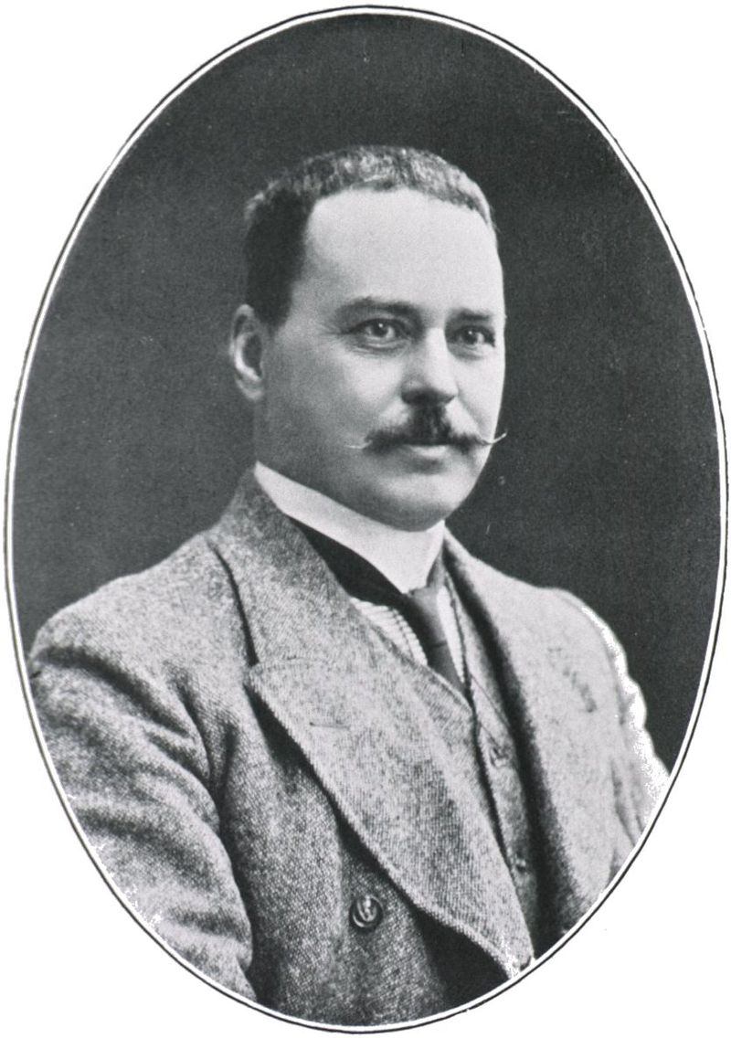
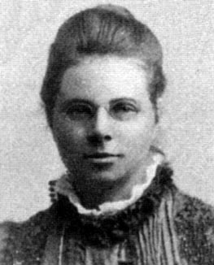
Modeling malaria
With the culprit identified, Ross tried to develop new methods to control malaria
Unlike his peers, he suspected malaria could be stopped without eliminating every single mosquito
With the help of mathematician Hilda Hudson, Ross developed the first mathematical models of malaria
Sir Ronald Ross
KCB KCMG FRS FRCS
Dr. Hilda Phoebe Hudson
OBE

Slide 23
The model works by subdividing the human and mosquito populations into:
Susceptible | Uninfected but able to become infected
Exposed | Infected but not infectious
Infectious | Infected and capable of transmitting
Recovered | Previously infected, now immune

Slide 24
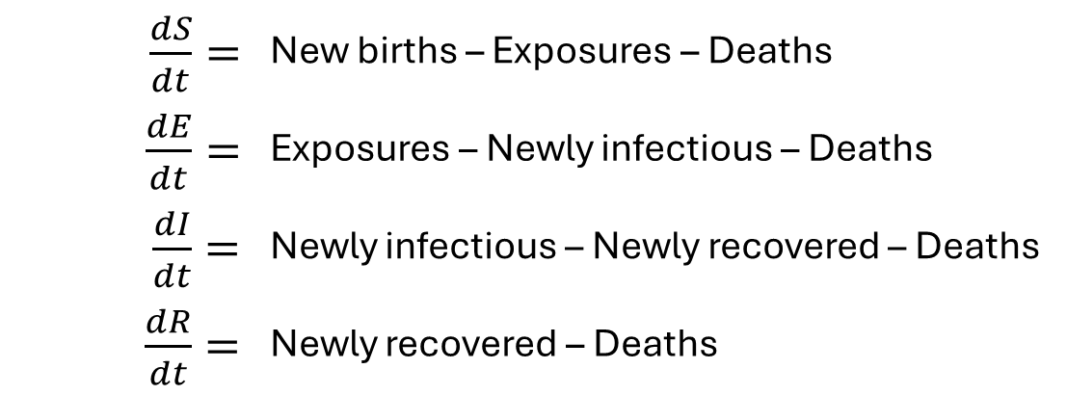
The model works by subdividing the human and mosquito populations into:
Susceptible | Uninfected but able to become infected
Exposed | Infected but not infectious
Infectious | Infected and capable of transmitting
Recovered | Previously infected, now immune
Then describing the transition rates among these subpopulations, that is:
$\frac{dS}{dt}=$ | New births – Exposures – Deaths
$\frac{dE}{dt}=$ | Exposures – Newly infectious – Deaths
$\frac{dI}{dt}=$ | Newly infectious – Newly recovered – Deaths
$\frac{dR}{dt}=$ | Newly recovered – Deaths

Slide 25
The model works by subdividing the human and mosquito populations into:
Susceptible | Uninfected but able to become infected
Exposed | Infected but not infectious
Infectious | Infected and capable of transmitting
Recovered | Previously infected, now immune
In modern times, we usually express these steps with a compartmental diagram
Then describing the transition rates among these subpopulations, that is:
$\frac{dS}{dt}=$ | New births – Exposures – Deaths
$\frac{dE}{dt}=$ | Exposures – Newly infectious – Deaths
$\frac{dI}{dt}=$ | Newly infectious – Newly recovered – Deaths
$\frac{dR}{dt}=$ | Newly recovered – Deaths

Slide 26
Vertebrate (host)
recruitment
mortality
Susceptible
Mosquito (vector)
recruitment
mortality
Susceptible

Slide 27
Vertebrate (host)
recruitment
mortality
mortality
Susceptible
Exposed
Transmission
Mosquito (vector)
recruitment
mortality
Susceptible

Slide 28
Vertebrate (host)
recruitment
mortality
mortality
mortality
Susceptible
Exposed
Infected
Transmission
Parasite
development
Mosquito (vector)
recruitment
mortality
Susceptible

Slide 29
Vertebrate (host)
recruitment
mortality
mortality
mortality
mortality
Susceptible
Exposed
Infected
Recovered
Transmission
recovery
Parasite
development
Mosquito (vector)
recruitment
mortality
Susceptible

Slide 30
Vertebrate (host)
recruitment
mortality
mortality
mortality
mortality
Susceptible
Exposed
Infected
Recovered
Transmission
recovery
Parasite
development
Mosquito (vector)
recruitment
mortality
mortality
Susceptible
Exposed
Transmission

Slide 31
Vertebrate (host)
recruitment
mortality
mortality
mortality
mortality
Susceptible
Exposed
Infected
Recovered
Transmission
recovery
Parasite
development
Mosquito (vector)
recruitment
mortality
mortality
mortality
Susceptible
Exposed
Infectious
Transmission
Parasite
development

Slide 32
Vertebrate (host)
recruitment
mortality
mortality
mortality
mortality
Susceptible
Exposed
Infected
Recovered
Transmission
recovery
Parasite
development
Mosquito (vector)
recruitment
mortality
mortality
mortality
Susceptible
Exposed
Infectious
Transmission
Parasite
development

Slide 33
Vertebrate (host)
recruitment
mortality
mortality
mortality
mortality
Susceptible
Exposed
Infected
Recovered
Transmission
recovery
Intrinsic incubation period
Mosquito (vector)
Extrinsic incubation period
recruitment
mortality
mortality
mortality
Susceptible
Exposed
Infectious
Transmission

Slide 34







Vertebrate (host)
recruitment
mortality
mortality
mortality
mortality
$$S_{h}$$
$$E_{h}$$
$$I_{h}$$
$$R_{h}$$
Transmission
recovery
Parasite
development
Mosquito (vector)
recruitment
mortality
mortality
mortality
$$S_{v}$$
$$E_{v}$$
$$I_{v}$$
Transmission
Parasite
development

Slide 35
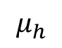
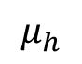
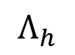
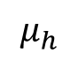
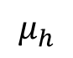
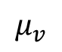
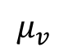
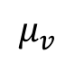
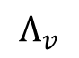
Vertebrate (host)
$$Λ_{h}$$
$$μ_{h}$$
$$μ_{h}$$
$$μ_{h}$$
$$μ_{h}$$
$$S_{h}$$
$$E_{h}$$
$$I_{h}$$
$$R_{h}$$
Transmission
recovery
Parasite
development
Mosquito (vector)
$$Λ_{v}$$
$$μ_{v}$$
$$μ_{v}$$
$$μ_{v}$$
$$S_{v}$$
$$E_{v}$$
$$I_{v}$$
Transmission
Parasite
development

Slide 36
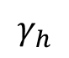
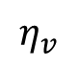
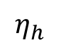
Vertebrate (host)
$$Λ_{h}$$
$$μ_{h}$$
$$μ_{h}$$
$$μ_{h}$$
$$μ_{h}$$
$$S_{h}$$
$$E_{h}$$
$$η_{h}$$
$$I_{h}$$
$$γ_{h}$$
$$R_{h}$$
Transmission
Mosquito (vector)
$$Λ_{v}$$
$$μ_{v}$$
$$μ_{v}$$
$$μ_{v}$$
$$S_{v}$$
$$E_{v}$$
$$η_{v}$$
$$I_{v}$$
Transmission

Slide 37
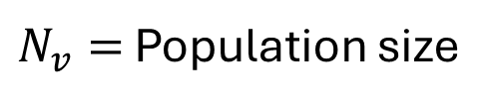
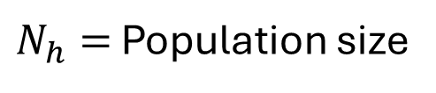
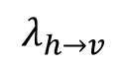
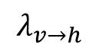
Vertebrate (host)
$N_{h}=$ Population size
$$Λ_{h}$$
$$μ_{h}$$
$$μ_{h}$$
$$μ_{h}$$
$$μ_{h}$$
$$S_{h}$$
$$E_{h}$$
$$η_{h}$$
$$I_{h}$$
$$γ_{h}$$
$$R_{h}$$
$$λ_{v→h}$$
Mosquito (vector)
$N_{v}=$ Population size
$$Λ_{v}$$
$$μ_{v}$$
$$μ_{v}$$
$$μ_{v}$$
$$S_{v}$$
$$E_{v}$$
$$η_{v}$$
$$I_{v}$$
$$λ_{h→v}$$

Slide 38
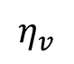
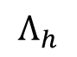
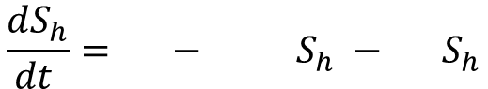
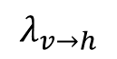
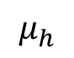
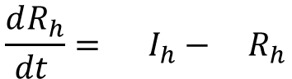
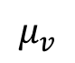
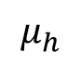
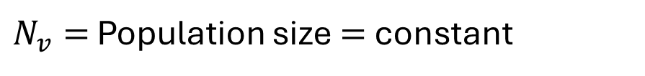
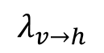
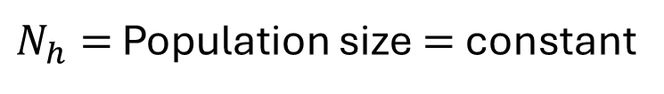
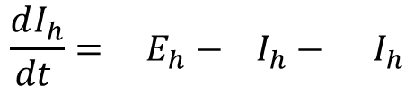
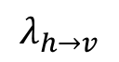















Vertebrate (host)
$N_{h}=$ Population size $=$constant
$$\frac{dS_{h}}{dt }= − S_{h} − S_{h}$$
$$Λ_{h}$$
$$λ_{v→h}$$
$$μ_{h}$$
$$\frac{dE_{h}}{dt }= S_{h}− E_{h}− E_{h}$$
$$λ_{v→h}$$
$$η_{h}$$
$$μ_{h}$$
$$\frac{dI_{h}}{dt }= E_{h}− I_{h}− I_{h}$$
$$η_{h}$$
$$γ_{h}$$
$$μ_{h}$$
$$\frac{dR_{h}}{dt }= I_{h}− R_{h}$$
$$γ_{h}$$
$$μ_{h}$$
Mosquito (vector)
$N_{v}=$ Population size $=$constant
$$\frac{dS_{v}}{dt }= − S_{v}− S_{v}$$
$$Λ_{v}$$
$$λ_{h→v}$$
$$μ_{v}$$
$$\frac{dE_{v}}{dt }= S_{v}− E_{v}− E_{v}$$
$$λ_{h→v}$$
$$μ_{v}$$
$$η_{v}$$
$$\frac{dI_{v}}{dt }= E_{v}− I_{v}$$
$$η_{v}$$
$$μ_{v}$$

Slide 39




Forces of infection
“What needs to happen for transmission to occur in a small time interval?”
$$\text{Per}\text{−}\text{capita} \text{Contact} \text{rate}×\text{Prob}\left(\text{contact} \text{was} \text{with} \text{an} \text{infectious} \text{individual}\right)×\text{Prob}\left(\text{contact} \text{leads} \text{to} \text{transmission}\right)$$
Transmission
to the
Vertebrate (host)
$$λ_{v→h}$$
$$=$$
Transmission
to the
Mosquito (vector)
$$λ_{h→v}$$
$$=$$

Slide 40
Forces of infection
“What needs to happen for transmission to occur in a small time interval?”
$$\text{Per}\text{−}\text{capita} \text{Contact} \text{rate}×\text{Prob}\left(\text{contact} \text{was} \text{with} \text{an} \text{infectious} \text{individual}\right)×\text{Prob}\left(\text{contact} \text{leads} \text{to} \text{transmission}\right)$$
Transmission
to the
Vertebrate (host)
$$λ_{v→h}$$
$$=$$
Transmission
to the
Mosquito (vector)
$$λ_{h→v}$$
$$=$$

Slide 41
Forces of infection
“What needs to happen for transmission to occur in a small time interval?”
$$\text{Per}\text{−}\text{capita} \text{Contact} \text{rate}×\text{Prob}\left(\text{contact} \text{was} \text{with} \text{an} \text{infectious} \text{individual}\right)×\text{Prob}\left(\text{contact} \text{leads} \text{to} \text{transmission}\right)$$
Transmission
to the
Vertebrate (host)
$$λ_{v→h}$$
$$=$$
Transmission
to the
Mosquito (vector)
$$λ_{h→v}$$
$$=$$

Slide 42

Forces of infection
$$\text{Per}\text{−}\text{capita} \text{Contact} \text{rate}×\text{Prob}\left(\text{contact} \text{was} \text{with} \text{an} \text{infectious} \text{individual}\right)×\text{Prob}\left(\text{contact} \text{leads} \text{to} \text{transmission}\right)$$
Transmission
to the
Vertebrate (host)
$$λ_{v→h}$$
$$=$$
$$b_{h}$$
$$\text{Per}\text{−}\text{capita} \text{Contact} \text{rate}×\text{Prob}\left(\text{contact} \text{was} \text{with} \text{an} \text{infectious} \text{individual}\right)×\text{Prob}\left(\text{contact} \text{leads} \text{to} \text{transmission}\right)$$
Transmission
to the
Mosquito (vector)
$$λ_{h→v}$$
$$=$$

Slide 43

Forces of infection
$$\text{Per}\text{−}\text{capita} \text{Contact} \text{rate}×\text{Prob}\left(\text{contact} \text{was} \text{with} \text{an} \text{infectious} \text{individual}\right)×\text{Prob}\left(\text{contact} \text{leads} \text{to} \text{transmission}\right)$$
Transmission
to the
Vertebrate (host)
“well-mixed” assumption
$$\frac{I_{v}}{N_{v}}$$
$$λ_{v→h}$$
$$=$$
$$b_{h}$$
$$\text{Per}\text{−}\text{capita} \text{Contact} \text{rate}×\text{Prob}\left(\text{contact} \text{was} \text{with} \text{an} \text{infectious} \text{individual}\right)×\text{Prob}\left(\text{contact} \text{leads} \text{to} \text{transmission}\right)$$
Transmission
to the
Mosquito (vector)
$$λ_{h→v}$$
$$=$$

Slide 44

Forces of infection
$$\text{Per}\text{−}\text{capita} \text{Contact} \text{rate}×\text{Prob}\left(\text{contact} \text{was} \text{with} \text{an} \text{infectious} \text{individual}\right)×\text{Prob}\left(\text{contact} \text{leads} \text{to} \text{transmission}\right)$$
Transmission
to the
Vertebrate (host)
$$\frac{I_{v}}{N_{v}}$$
$$λ_{v→h}$$
$$=$$
$$b_{h}$$
$$β_{h}$$
$$\text{Per}\text{−}\text{capita} \text{Contact} \text{rate}×\text{Prob}\left(\text{contact} \text{was} \text{with} \text{an} \text{infectious} \text{individual}\right)×\text{Prob}\left(\text{contact} \text{leads} \text{to} \text{transmission}\right)$$
Transmission
to the
Mosquito (vector)
$$λ_{h→v}$$
$$=$$

Slide 45



Forces of infection
$$\text{Per}\text{−}\text{capita} \text{Contact} \text{rate}×\text{Prob}\left(\text{contact} \text{was} \text{with} \text{an} \text{infectious} \text{individual}\right)×\text{Prob}\left(\text{contact} \text{leads} \text{to} \text{transmission}\right)$$
Transmission
to the
Vertebrate (host)
$$\frac{I_{v}}{N_{v}}$$
$$λ_{v→h}$$
$$=$$
$$b_{h}$$
$$β_{h}$$
Transmission
to the
Mosquito (vector)
“well-mixed” assumption
$$\frac{I_{h}}{N_{h}}$$
$$λ_{h→v}$$
$$=$$
$$b_{v}$$
$$β_{v}$$
$$\text{Per}\text{−}\text{capita} \text{Contact} \text{rate}×\text{Prob}\left(\text{contact} \text{was} \text{with} \text{an} \text{infectious} \text{individual}\right)×\text{Prob}\left(\text{contact} \text{leads} \text{to} \text{transmission}\right)$$

Slide 46








Forces of infection
Transmission
to the
Vertebrate (host)
$$\frac{I_{v}}{N_{v}}$$
$$λ_{v→h}=$$
$$b_{h}$$
$$β_{h}$$
Transmission
to the
Mosquito (vector)
$$\frac{I_{h}}{N_{h}}$$
$$λ_{h→v}=$$
$$b_{v}$$
$$β_{v}$$

Slide 47




Contact rates
Contact experienced by
the
Vertebrate (host)
$$b_{h}$$
$=$ bites per host per day
Contact experienced by
the
Mosquito (vector)
$$b_{v}$$
$=$ bites per mosquito per day

Slide 48
Contact Biting rates
Contact experienced by
the
Vertebrate (host)
$$b_{h}$$
$=$ bites per host per day
Contact experienced by
the
Mosquito (vector)
$$b_{v}$$
$=$ bites per mosquito per day

Slide 49


Contact Biting rates
Contact experienced by
the
Vertebrate (host)
$$b_{h}$$
$=$ bites per host per day
Contact experienced by
the
Mosquito (vector)
$$b_{v}$$
$=$ bites per mosquito per day
Balance Equation
$\frac{\text{Bites}}{\text{Host} × \text{day}}×\text{Host} \text{population}$
Bites per day
$$=$$

Slide 50

Contact Biting rates
Contact experienced by
the
Vertebrate (host)
$$b_{h}$$
$=$ bites per host per day
Contact experienced by
the
Mosquito (vector)
$$b_{v}$$
$=$ bites per mosquito per day
Contact Balance Equation
$\frac{\text{Bites}}{\text{Host} × \text{day}}×\text{Host} \text{population}$
Bites per day
$$=$$
$$\frac{\text{Bites}}{\text{Mosquito} × \text{day}}×\text{Mosquito} \text{population}$$
Bites per day
$$=$$

Slide 51


Contact Biting rates
Contact experienced by
the
Vertebrate (host)
$$b_{h}$$
$=$ bites per host per day
Contact experienced by
the
Mosquito (vector)
$$b_{v}$$
$=$ bites per mosquito per day
Contact Balance Equation
Bites per day
$$=$$
$$b_{h}N_{h}$$
Bites per day
$$=$$
$$b_{v}N_{v}$$

Slide 52



Contact rates
Contact experienced by
the
Vertebrate (host)
$$b_{h}$$
$=$ bites per host per day
Contact experienced by
the
Mosquito (vector)
$$b_{v}$$
$=$ bites per mosquito per day
Contact Balance Equation
$$b_{h}N_{h}$$
$$=$$
$$b_{v}N_{v}$$

Slide 53

Contact Biting rates
Contact experienced by
the
Vertebrate (host)
$$b_{h}$$
$=$ bites per host per day
Contact experienced by
the
Mosquito (vector)
$$b_{v}$$
$=$ bites per mosquito per day
$=$Assumed constant
Contact Balance Equation
$$b_{h}N_{h}$$
$$=$$
$$b_{v}N_{v}$$

Slide 54



Contact Biting rates
Contact experienced by
the
Vertebrate (host)
$$b_{h}$$
$=$ bites per host per day
Contact experienced by
the
Mosquito (vector)
$$b_{v}$$
$=$ bites per mosquito per day
$=$Assumed constant
Contact Balance Equation
$$b_{h}N_{h}$$
$$=$$
$$b_{v}N_{v}$$
$$b_{v}\frac{N_{v}}{N_{h}}$$
$$b_{h}$$
$$=$$

Slide 55




Contact Biting rates
Contact experienced by
the
Vertebrate (host)
$$b_{v}\frac{N_{v}}{N_{h}}$$
$$b_{h}=$$
Contact experienced by
the
Mosquito (vector)
$$b_{v}=$$
$b_{v}$

Slide 56










Forces of infection
Transmission
to the
Vertebrate (host)
$$b_{v}\frac{N_{v}}{N_{h}}$$
$$\frac{I_{v}}{N_{v}}$$
$$b_{v}\frac{1}{N_{h}}I_{v}β_{h}$$
$$λ_{v→h}$$
$$=$$
$$β_{h}$$
$$=$$
Transmission
to the
Mosquito (vector)
$$\frac{I_{h}}{N_{h}}$$
$$λ_{h→v}$$
$$=$$
$b_{v}$
$$β_{v}$$

Slide 57

























Vertebrate (host)
$N_{h}=$ Population size $=$constant
$$b_{v}\frac{1}{N_{h}}I_{v}β_{h}$$
$$\frac{dS_{h}}{dt }= − S_{h}− S_{h}$$
$$Λ_{h}$$
$$μ_{h}$$
$$b_{v}\frac{1}{N_{h}}I_{v}β_{h}$$
$$\frac{dE_{h}}{dt }= S_{h}− E_{h}− E_{h}$$
$$η_{h}$$
$$μ_{h}$$
$$\frac{dI_{h}}{dt }= E_{h}− I_{h}− I_{h}$$
$$η_{h}$$
$$γ_{h}$$
$$μ_{h}$$
$$\frac{dR_{h}}{dt }= I_{h}− R_{h}$$
$$γ_{h}$$
$$μ_{h}$$
Mosquito (vector)
$N_{v}=$ Population size $=$constant
$$\frac{I_{h}}{N_{h}}$$
$$\frac{dS_{v}}{dt }= − S_{v}− S_{v}$$
$$Λ_{v}$$
$b_{v}$
$$β_{v}$$
$$μ_{v}$$
$$\frac{I_{h}}{N_{h}}$$
$$\frac{dE_{v}}{dt }= S_{v}− E_{v}− E_{v}$$
$b_{v}$
$$β_{v}$$
$$μ_{v}$$
$$η_{v}$$
$$\frac{dI_{v}}{dt }= E_{v}− I_{v}$$
$$η_{v}$$
$$μ_{v}$$

Slide 58







Vertebrate (host)
$N_{h}=$ Population size $=$constant
$$\frac{dE_{h}}{dt }=b_{v}\frac{1}{N_{h}}I_{v}β_{h}\left(N_{h}−E_{h}−I_{h}−R_{h}\right)−η_{h}E_{h}−μ_{h}E_{h}$$
$$\frac{dI_{h}}{dt }=η_{h}E_{h}−γ_{h}I_{h}−μ_{h}I_{h}$$
$$\frac{dR_{h}}{dt }=γ_{h}I_{h}−μ_{h}R_{h}$$
Mosquito (vector)
$N_{v}=$ Population size $=$constant
$$\frac{dE_{v}}{dt }=b_{v}\frac{I_{h}}{N_{h}}β_{v}\left(N_{v}−E_{v}−I_{v}\right)−η_{v}E_{v}−μ_{v}E_{v}$$
$$\frac{dI_{v}}{dt }=η_{v}E_{v}−μ_{v}I_{v}$$

Slide 59


Stability analysis of the disease-free equilibrium
For what parameter values: will there be an outbreak?
will transmission persist into the future?
Disease-free Equilibrium:
$S_{h}=N_{h}$, $E_{h}=I_{h}=R_{h}=0$
$S_{v}=N_{v}$, $E_{v}=I_{v}=0$

Slide 60



Stability analysis of the disease-free equilibrium
For what parameter values: will there be an outbreak?
will transmission persist into the future?
Disease-free Equilibrium:
$S_{h}=N_{h}$, $E_{h}=I_{h}=R_{h}=0$
$S_{v}=N_{v}$, $E_{v}=I_{v}=0$
Jacobian
$$J=\left[\begin{matrix}−b_{v}\frac{1}{N_{h}}I_{v}β_{h}−η_{h}−μ_{h} & −b_{v}\frac{1}{N_{h}}I_{v}β_{h} & −b_{v}\frac{1}{N_{h}}I_{v}β_{h} & 0 & b_{v}\frac{1}{N_{h}}β_{h}\left(N_{h}−E_{h}−I_{h}−R_{h}\right) \\ η_{h} & −γ_{h}−μ_{h} & 0 & 0 & 0 \\ 0 & γ_{h} & −μ_{h} & 0 & 0 \\ 0 & b_{v}\frac{1}{N_{h}}β_{v}\left(N_{v}−E_{v}−I_{v}\right) & 0 & −b_{v}\frac{I_{h}}{N_{h}}β_{v}−η_{v}−μ_{v} & −b_{v}\frac{I_{h}}{N_{h}}β_{v} \\ 0 & 0 & 0 & η_{v} & −μ_{v}\end{matrix}\right]$$

Slide 61

Stability analysis of the disease-free equilibrium
For what parameter values: will there be an outbreak?
will transmission persist into the future?
Disease-free Equilibrium:
$S_{h}=N_{h}$, $E_{h}=I_{h}=R_{h}=0$
$S_{v}=N_{v}$, $E_{v}=I_{v}=0$
Jacobian evaluated at the disease-free equilibrium:
$$J_{0}=\left[\begin{matrix}−η_{h}−μ_{h} & 0 & 0 & 0 & b_{v}β_{h} \\ η_{h} & −γ_{h}−μ_{h} & 0 & 0 & 0 \\ 0 & γ_{h} & −μ_{h} & 0 & 0 \\ 0 & b_{v}β_{v}\frac{N_{v} }{N_{h}} & 0 & −η_{v}−μ_{v} & 0 \\ 0 & 0 & 0 & η_{v} & −μ_{v}\end{matrix}\right]$$

Slide 62

Stability analysis of the disease-free equilibrium
For what parameter values: will there be an outbreak?
will transmission persist into the future?
Disease-free Equilibrium:
$S_{h}=N_{h}$, $E_{h}=I_{h}=R_{h}=0$
$S_{v}=N_{v}$, $E_{v}=I_{v}=0$
Eigenvalue(s) of the Jacobian evaluated at the disease-free equilibrium:
aka the basic reproduction number
$$ℛ_{0}=\sqrt{\left(b_{v}β_{h}\frac{N_{v}}{N_{h}}\frac{η_{h}}{η_{h}+μ_{h}}\frac{1}{γ_{h}+μ_{h}}\right)\left(b_{v}β_{v}\frac{η_{v}}{η_{v}+μ_{v}}\frac{1}{μ_{v}}\right)}$$

Slide 63


The basic reproduction number
$$ℛ_{0}=\sqrt{\left(b_{v} \frac{N_{v}}{N_{h}}β_{h}\frac{η_{h}}{η_{h}+μ_{h}}\frac{1}{γ_{h}+μ_{h}}\right)\left(b_{v}β_{v}\frac{η_{v}}{η_{v}+μ_{v}}\frac{1}{μ_{v}}\right)}$$
Theorem:
If $ℛ_{0}>1$, the disease will be epidemic: it will cause a large outbreak and endemic: it will persist into the future.
If $ℛ_{0}<1$, the disease-free equilibrium is stable: transmission will decrease over time.

Slide 64


Theorem:
If $ℛ_{0}>1$, the disease will be epidemic: it will cause a large outbreak and endemic: it will persist into the future.
If $ℛ_{0}<1$, the disease-free equilibrium is stable: transmission will decrease over time.
Critical vector density threshold:
Set $ℛ_{0}\left(N_{v}^{c}\right)=\sqrt{\left(b_{v} \frac{N_{v}^{c}}{N_{h}}β_{h}\frac{η_{h}}{η_{h}+μ_{h}}\frac{1}{γ_{h}+μ_{h}}\right)\left(b_{v}β_{v}\frac{η_{v}}{η_{v}+μ_{v}}\frac{1}{μ_{v}}\right)}=1$ and
Solve for $N_{v}$ to get $N_{v}^{c}$.
If $N_{v}<N_{v}^{c}$, then transmission will cease.

Slide 65

Critical vector density threshold:
Set $ℛ_{0}\left(N_{v}^{c}\right)=\sqrt{\left(b_{v} \frac{N_{v}^{c}}{N_{h}}β_{h}\frac{η_{h}}{η_{h}+μ_{h}}\frac{1}{γ_{h}+μ_{h}}\right)\left(b_{v}β_{v}\frac{η_{v}}{η_{v}+μ_{v}}\frac{1}{μ_{v}}\right)}=1$ and
Solve for $N_{v}$ to get $N_{v}^{c}$.
If $N_{v}<N_{v}^{c}$, then transmission will cease.
With this finding, Ross could argue for interventions which reduced mosquito densities but didn’t necessarily guarantee their total eradication:
Achieving and keeping mosquito densities below this threshold should ensure that malaria transmission will continue to decrease over time.

Slide 66



This understanding led to the implementation of mosquito control methods:
draining stagnant water, using insecticides, and
introducing mosquito nets,
as immediate, practical measures in malaria-endemic areas.

Slide 67



The basic reproduction number
$$ℛ_{0}=\sqrt{\left(b_{v} \frac{N_{V}}{N_{h}} β_{h} \frac{η_{h}}{η_{h}+μ_{h}} \frac{1}{γ_{h}+μ_{h}}\right)\left(b_{v}β_{v} \frac{η_{v}}{η_{v}+μ_{v}} \frac{1}{μ_{v}}\right)}$$
$$ℛ_{h}=\sqrt{\left(b_{v} \frac{N_{V}}{N_{h}} β_{h} \frac{η_{h}}{η_{h}+μ_{h}} \frac{1}{γ_{h}+μ_{h}}\right)\left(b_{v}β_{v} \frac{η_{v}}{η_{v}+μ_{v}} \frac{1}{μ_{v}}\right)}$$
$$ℛ_{v}=\sqrt{\left(b_{v} \frac{N_{V}}{N_{h}} β_{h} \frac{η_{h}}{η_{h}+μ_{h}} \frac{1}{γ_{h}+μ_{h}}\right)\left(b_{v}β_{v} \frac{η_{v}}{η_{v}+μ_{v}} \frac{1}{μ_{v}}\right)}$$
Pr(host survives incubation period)
Pr(mosquito survives incubation period)
Host infectious period

Slide 68
Modern: Outline
Beyond India: Where did we stand at the end of the 20th Century?
If I haven’t already, show that malaria prevalence used to be high worldwide
Introduce Yellow Fever, something they’ve probably heard of but aren’t aware of how terrible it was
Focus on the United States for this audience, see if we can zoom in on Virginia.
Serious interventions for malaria and Yellow Fever did not start being enacted until WWII
Show Disney edutainment video
The invention of DDT
We know from Ross’ Model that reducing larval availability is key. There aren’t really any other clear interventions at this time. DDT was super effective at killing mosquito larvae in any habitat, was super easy to apply.
This eliminated the threat of malaria and Yellow Fever from the United States and countries across the world, saving tens of millions of lives.
But, as you might know, the impacts of DDT on other wildlife was considered too detrimental to justify it’s use worldwide
Mathematical innovations for addressing the threat of mosquito-borne diseases
The effectiveness of bed nets
The sterile insect technique and, more recently, the infertile insect technique using Wolbachia cytoplasmic incompatibility and AI-driven mosquito sexing
Identifying reservoirs of mosquito-borne parasites in the wild. Where might the next mosquito-borne disease emerge?
The story of Zika. A disease that mostly affected South America, originated in Africa, and evolved its outbreak potential in Polynesia.
Be sure to focus on how it emerged out of Africa
Notes:
References:
Smith, David L., T. Alex Perkins, Robert C. Reiner Jr, Christopher M. Barker, Tianchan Niu, Luis Fernando Chaves, Alicia M. Ellis, et al. 2014. “Recasting the Theory of Mosquito-Borne Pathogen Transmission Dynamics and Control.” Transactions of the Royal Society of Tropical Medicine and Hygiene 108 (4): 185–97. https://doi.org/10.1093/trstmh/tru026.

Slide 69
Modern: Outline
Recent topics (as time allows)
Coupled within-host and between-host models
Effects of temperature
Spatial and movement modeling
Infertile insect techniques
Notes:
References:
Smith, David L., T. Alex Perkins, Robert C. Reiner Jr, Christopher M. Barker, Tianchan Niu, Luis Fernando Chaves, Alicia M. Ellis, et al. 2014. “Recasting the Theory of Mosquito-Borne Pathogen Transmission Dynamics and Control.” Transactions of the Royal Society of Tropical Medicine and Hygiene 108 (4): 185–97. https://doi.org/10.1093/trstmh/tru026.

Slide 70
Recent modern topics
Coupled within-host and between-host models
Effects of temperature
Spatial and movement modeling
Infertile insect techniques
Notes:
References:
Smith, David L., T. Alex Perkins, Robert C. Reiner Jr, Christopher M. Barker, Tianchan Niu, Luis Fernando Chaves, Alicia M. Ellis, et al. 2014. “Recasting the Theory of Mosquito-Borne Pathogen Transmission Dynamics and Control.” Transactions of the Royal Society of Tropical Medicine and Hygiene 108 (4): 185–97. https://doi.org/10.1093/trstmh/tru026.

Slide 71


Coupled within- and between-host models

Slide 72

Coupled within- and between-host models

Slide 73



Effects of temperature on transmission
Mosquito equations
Host equations

Slide 74
Effects of temperature on transmission
Mosquito equations
Temperature-dependent parameter
Host equations

Slide 75



Effects of temperature on transmission

Slide 76




Spatial and movement modeling

Slide 77


Spatial and movement modeling
Connectivity network for Namibia

